Slide 1
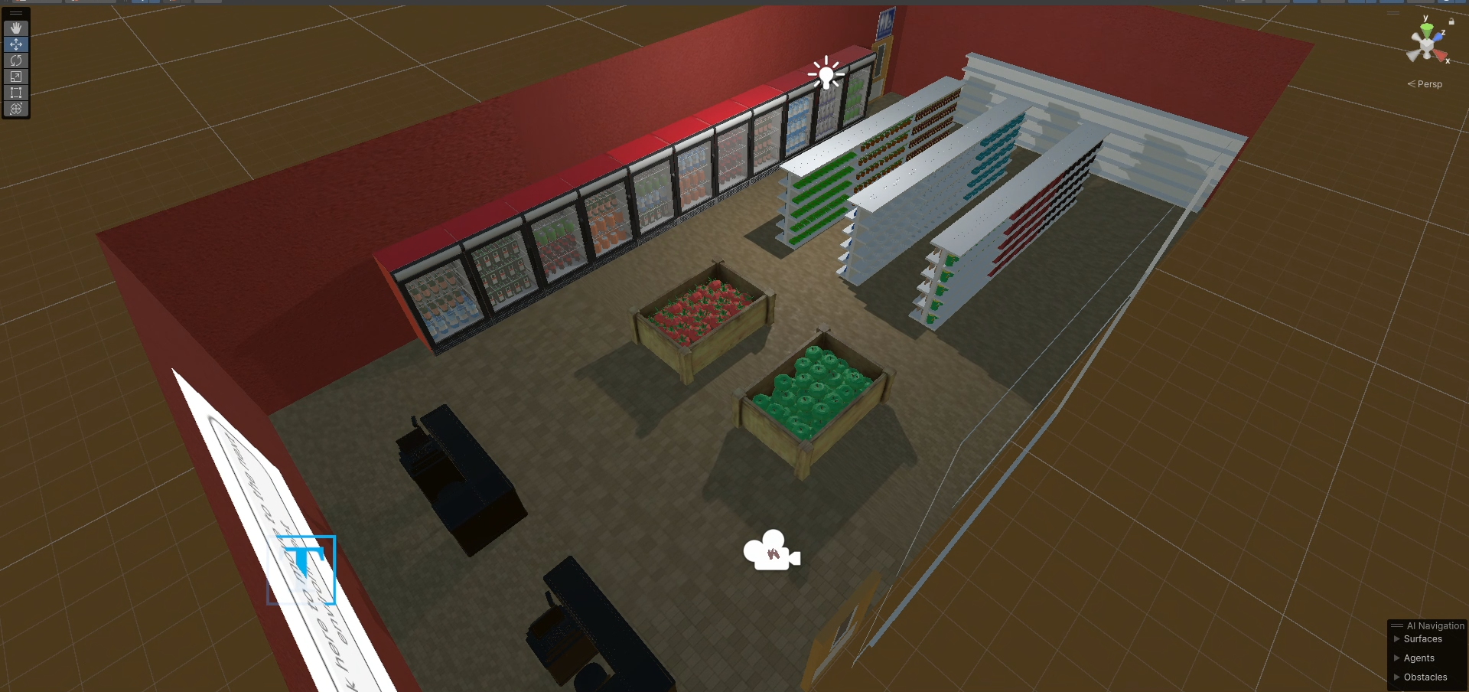
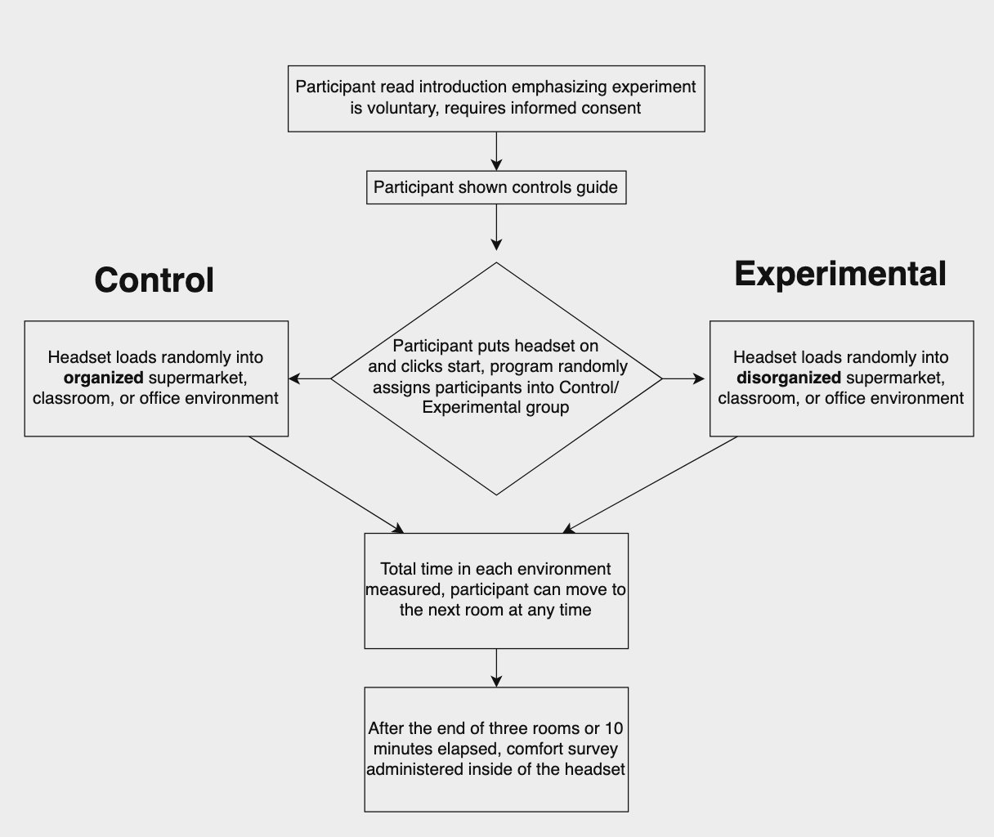
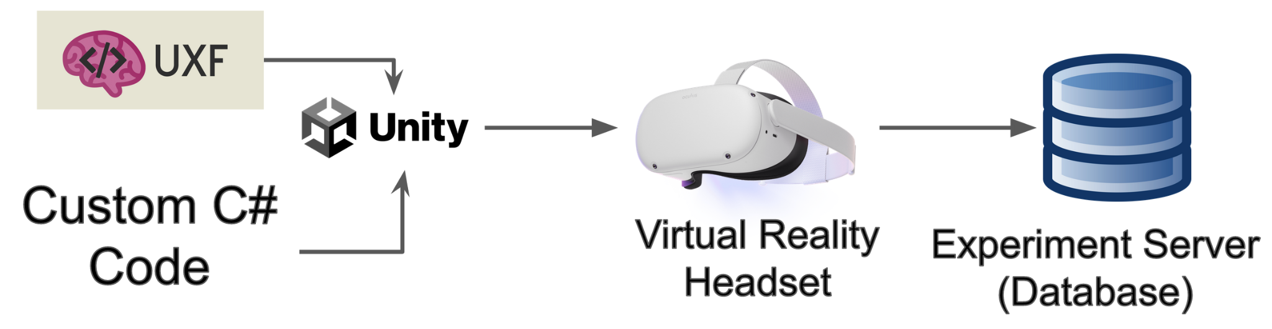
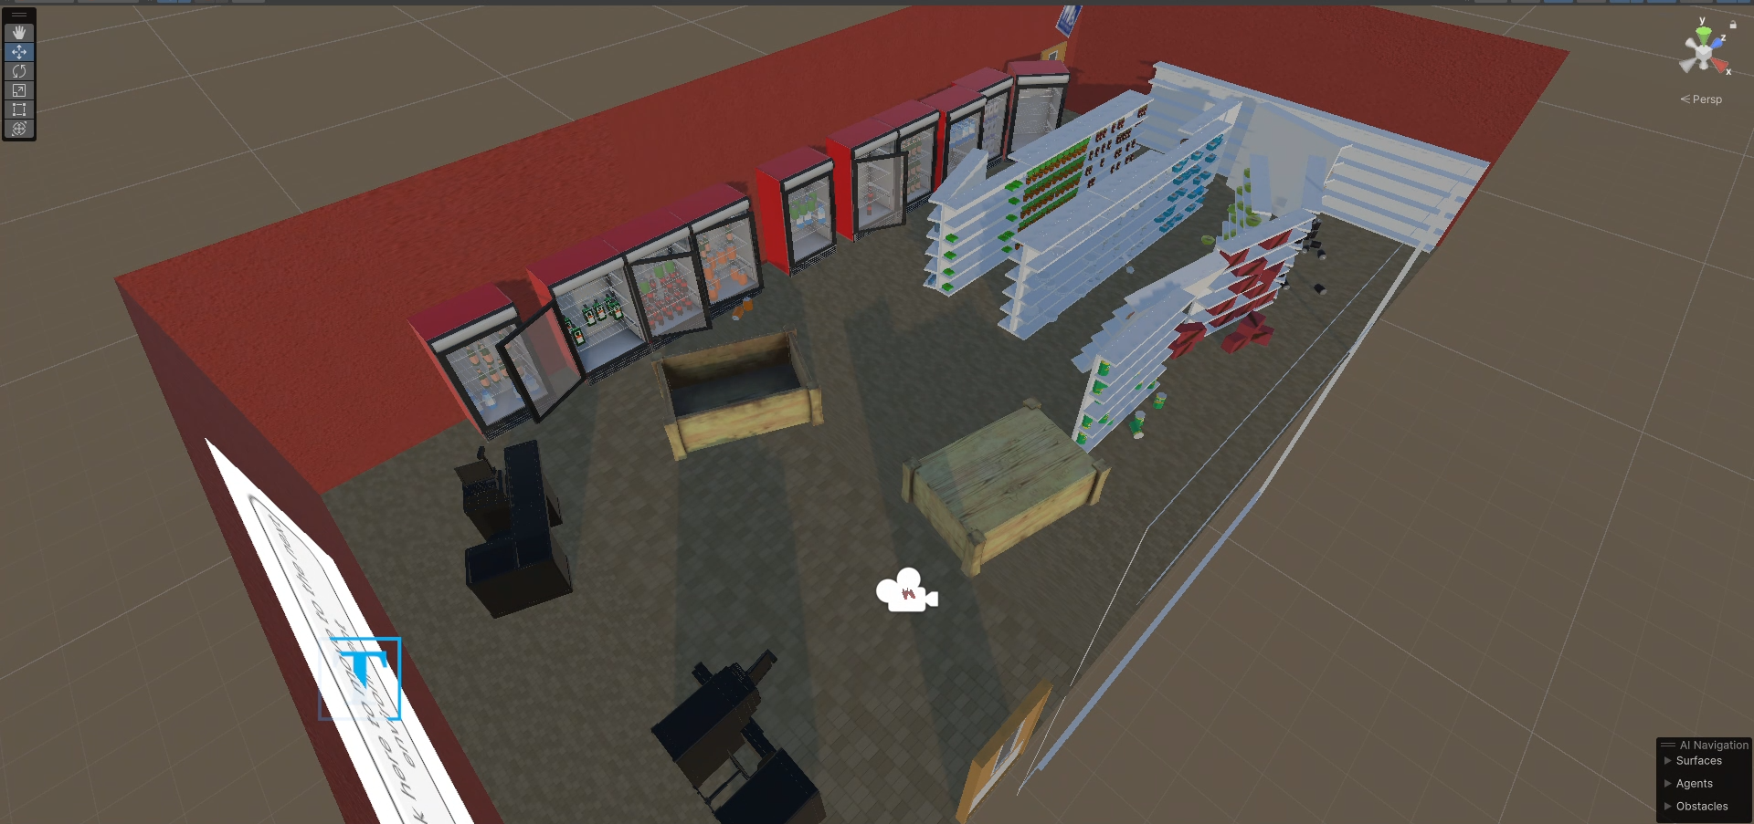
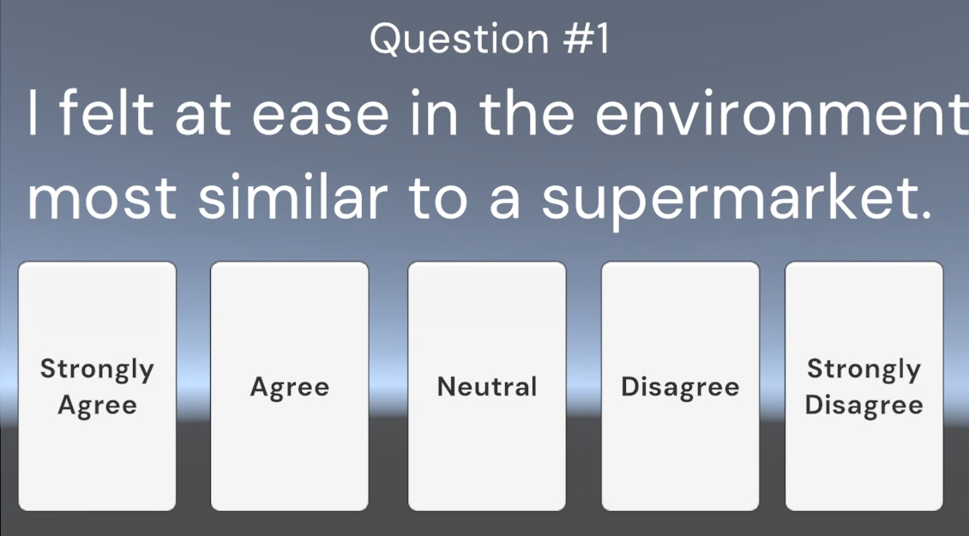
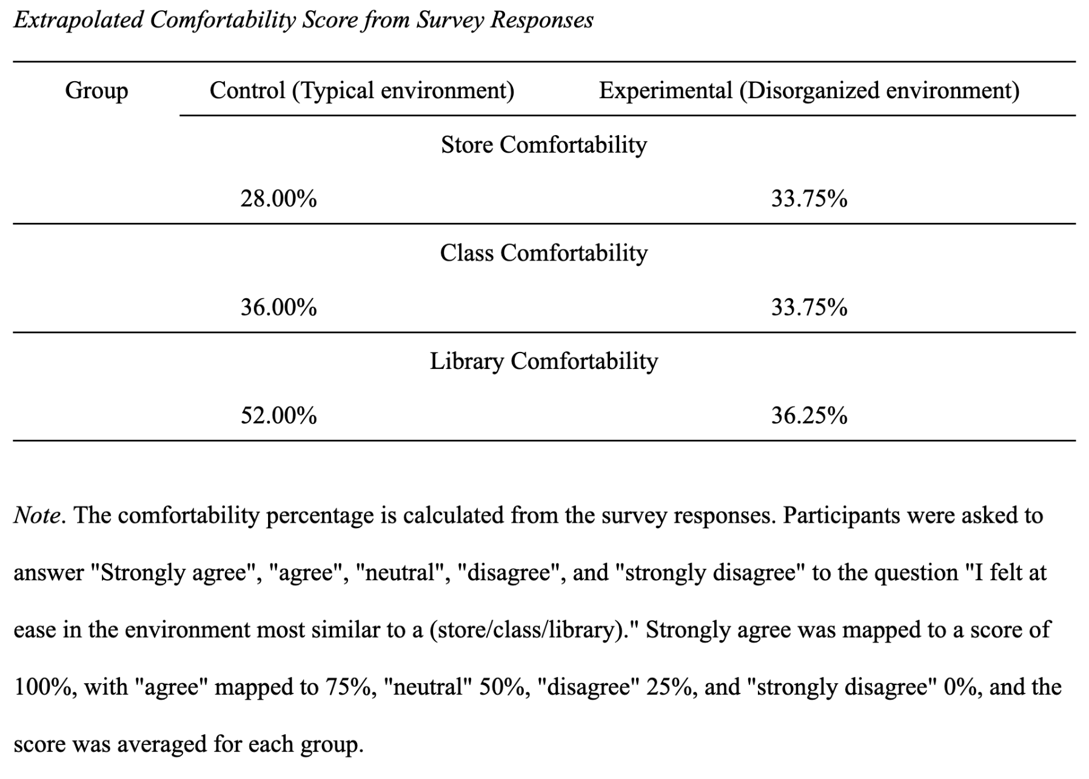
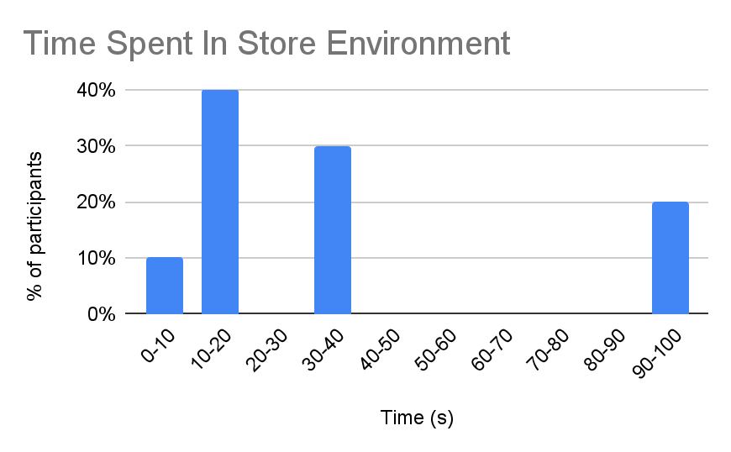
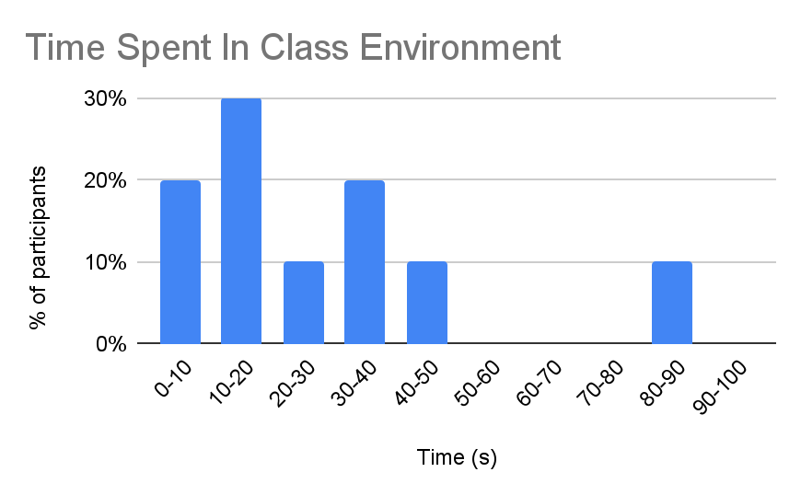
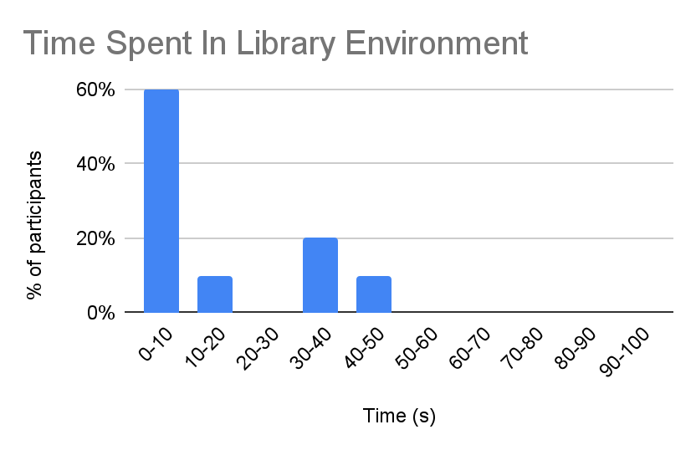
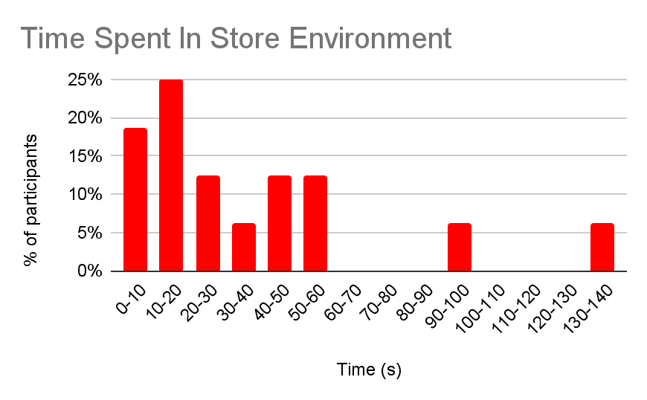
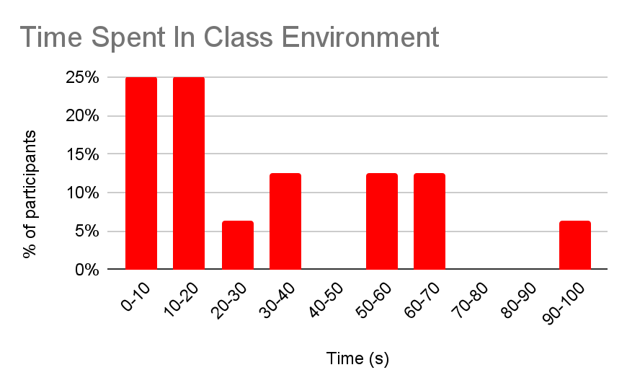
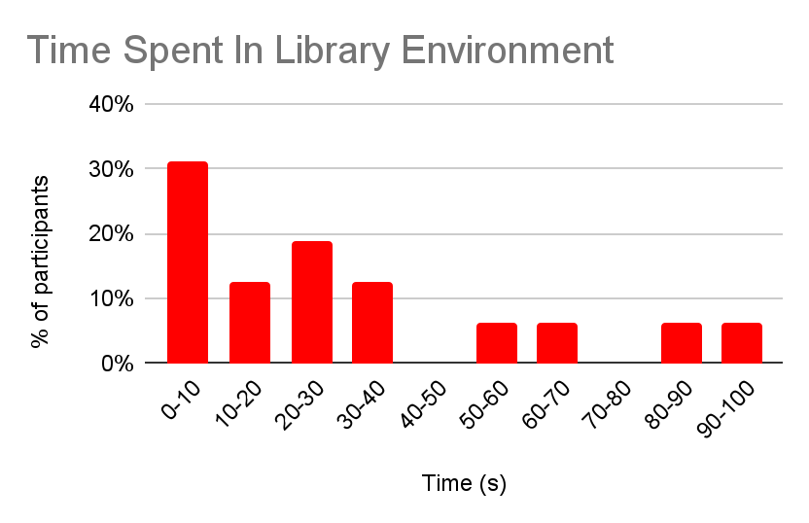
Abstract/Overview
Conclusion
Liminal Spaces and the Uncanny Valley:
We use a case study experiment to show the feasibility of virtual reality technologies in creating psychological experimental design environments. Through the use of video game engines such as Unity, virtual reality can be an effective tool to prototype psychology research designs.
To prototype psychology research design, experiments are built with a framework that allows for precise data collection such as UXF (Unity Experiment Framework) and combined with custom code alongside the Unity Game engine to create a VR application that runs on a Meta Quest 2 virtual reality headset.
An Interdisciplinary Virtual Reality and Psychology Experimental Research Design
By Aaron Chen, Ethan Wang, and James Kerrane
In the context of our research question, our data reflected interesting points, most notably that in liminal spaces, comfortability decreased while time spent increased. This was most likely due to increased intractability/curiosity which diverted the attention of the subjects from moving on to the next room. While it proves the uncomfortability that liminal spaces are meant to create, it poses the idea that in spite of being in a space that causes a negative feeling to occur, people are willing/more likely to explore their surroundings. However, since this was done in a virtual environment, it is unknown whether these results would translate one-to-one to real life as these experiments were conducted in a normal space. As well, the virtual environments themselves were not created in a way that perfectly reflected reality, so there could be some disconnect there as well.
Design Procedure
Experimental Procedure
CONTROL
Image by James Kerrane
Image by Aaron Chen
EXPERIMENTAL
Image by James Kerrane
Background Research
Image by Aaron Chen
To test comfortability we built three main scenes: a classroom, a library, and a convenience store. The idea was to create a generic layout of what these places look like in real life, and then duplicate each scene and shift some of the objects within the scene to create a liminal space. In total, we had six scenes, three scenes that represented what most people assume is a store/library/classroom, whereas the other three were created as liminal spaces.
Our research consisted of understanding what creates liminal spaces and what liminal spaces were, as well as understanding how to utilize Unity and Virtual Reality for this experiment. Liminal spaces are often associated with spaces that cause some sort of discomfort or unease, due to some sort of distortion or misalignment of objects that create a sense of unknown. These distortions could stem from the physical sizes or location of objects within a room, or the lack of an object in a room.
Image by James Kerrane
Results
Control (n = 10)
Research Question
Graphs by Ethan Wang
Future Directions
Does the organization of an otherwise known public space cause users to feel unsettling feelings?
Outside the experiment, the idea of utilizing virtual reality outside of entertainment purposes could allow more widespread use of the technology for various psychological experiments as a way to replicate human behavior. The use of VR is already used in forms of exposure therapy, as a cheaper means to be able to treat those with PTSD. As well, the concept of liminal spaces could aid in the creation of various spaces for people returning to in-person workspaces after the COVID pandemic: creating spaces that people would feel comfortable in.
Hypothesis
People placed in spaces where the objects appear scattered or recently used will spend less time in those spaces than people placed in spaces where the objects are neatly organized.
People placed in spaces where the objects appear scattered or recently used will feel more discomfort than people placed in spaces where the objects are neatly organized.
Experimental (n = 16)
Graphs by Ethan Wang

